Slide 1
Lumbar Spine Degenerative Classification BackProp for Back
Thursday, November 7, 2024
Presented by: Paul Schmelzer
Introduce the different from mri images into pppt, and

Slide 2
Project Overview
Objective: classify lumbar spine degenerative conditions using MR images.
Low Back Pain Impact: Affects 619 million people globally
Importance of MRI: Detailed views of vertebrae, discs, and nerves for accurate assessment.

Slide 3
Project Overview
Goal: Facilitate radiologist performance in diagnosing spine conditions for improved patient outcomes.
Shorten times between MRI and diagnosis by radiologist
A tool to help non-radiologists act quickly until a neurosurgeon appointment
As second opinion for patients

Slide 4
Dataset
Dataset Origin from Kaggle: From 8 global sites, across 5 continents collected by RSNA (Radiological Society of North America)
Conditions: Classifying five lumbar spine degenerative conditions:
Left Neural Foraminal Narrowing
Right Neural Foraminal Narrowing
Left Subarticular Stenosis
Right Subarticular Stenosis
Spinal Canal Stenosis
Severity Levels: Normal/Mild, Moderate, Severe.
Grading by Disc Levels: Severity scores across L1/L2 to L5/S1 disc levels.

Slide 5
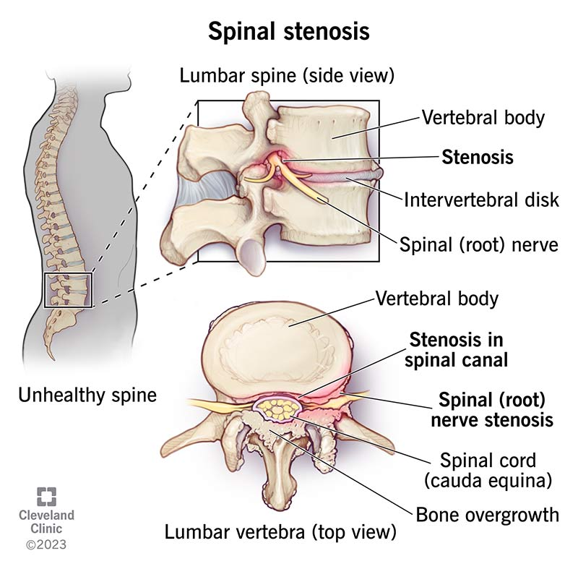

Slide 6
Dataset
Image Categories (stored in folders)
Sagittal T2/STIR
Sagittal T1
Axial T2
Sagittal Images:
Show the entire spine, providing more context for detecting stenosis and neural foraminal narrowing.
Axial Images:
Only show localized parts of the spine, limiting their effectiveness for detecting foraminal narrowing when only one image per person is available.
Risk of selecting an incorrect position if Axial images are used.

Slide 7
Dataset for the first step
Research Focus: Left Neural Foraminal Narrowing at L5/S1.
Localization: Focusing on one degenerative condition and one location due to computational limits.
Image Selection: Only one image per person, using sagittal images (T2/STIR and T1).
Reasoning: axial images only show one part of the vertebra and are not suitable for stenosis assessment.
About 2000 persons
100 equally sampled persons with respect to severity
Severity | Normal/mild | Moderate | Severe
N | 1247 | 520 | 206

Slide 8
Methods - Pretrained Transfer Learning with ResNet-50
Purpose
Applying pretrained convolutional neural network (CNN)
Accelerate model training
Improve performance on medical images
ResNet-50
Layers: 50 layers with residual connections
Technique: Residual learning (skips connections for better performing in deep layers)
Application: Ideal for deep learning on complex, layered datasets
Next steps
Introducing own layers to improve performance of the original model
Notes:
standard deep networks, gradients can become very small as they are backpropagated through many layers, causing the model to struggle with learning in deeper layer

Slide 9
Preliminasry Results
100 individuals with one image pro person
Predictions with 100 individuals per severity classification range between 35% and 37%
Changing layers in the model did not improve the results
New Sample Strategy
Cases with medium and severe severity are undersampled in terms of persons, but balanced in terms of images.
For each person, there are 4000 images (4000 x 3 = 12000)
Train-test split 80% for training and 20% for testing.
Train validation split 80% for training and 20% for testing.
Calculation time on the training set is approximately 4 hours.
Early stopping after 5 epochs due to divergence between the validation and training

Slide 10
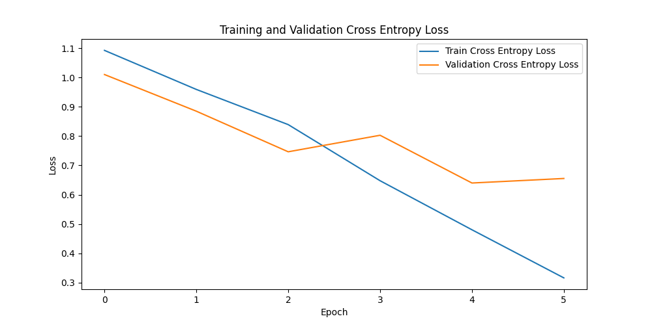

Slide 11
Preliminary Results
 | Prediction normal | Probability medium | Probability severe
 | 0.33 | 0.33 | 0.33
normal | 0.42 | 0.50 | 0.06
medium | 0.22 | 0.63 | 0.13
severe | 0.11 | 0.68 | 0.19
Last category prediction: (Severe ) is predicted very poorly.
Misclassification: Severe damage predicted as the second category (Moderate).

Slide 12
Preliminary Results
Reasoning: There is no clear distinction between medium and severe severity.
Diagnosis Complexity: Severity is not determined by images alone—symptoms play a crucial role in deciding the condition.
Definition Problem: The training data contains images labeled with damage severity (e.g., mild, moderate, severe).
However, is the decision of how much damage qualifies as "big" or "small" standardized?
=> Combining Medium and Severe Categories
Decision: Due to the lack of clear distinction, the Medium and Severe categories have been combined into a single "Damage or Not Damage" classification.

Slide 13
Preliminary Results
Strategy
Reduction to two classes:
Cases with medium + severe vs. normal severitySeverity
Nmal/mild
Sampling
Cases with medium and severe severity are undersampled in terms of persons, but balanced in terms of images.
For each person, there are 7000 images (7000 x 2 = 14000)
Train-test split 80% for training and 20% for testing.
Train validation split 80% for training and 20% for testing.
Calculation time on the training set is approximately 6 hours.
Early stopping after 6 epochs due to divergence between the validation and training
Moderate

Slide 14
Preliminary Results
After getting domain knowledge
Strategy
Taking axial MRI for predicting spinal damages:
Cases with medium + severe vs. normal severity
ity
Nmal/mild
Sampling
Cases with medium and severe severity are undersampled in terms of persons, but balanced in terms of images.
For each person, there are 7000 images (7000 x 2 = 14000)
Train-test split 80% for training and 20% for testing.
Train validation split 80% for training and 20% for testing.
Moderate

Slide 15
Next steps
Nice to have:
Localization of the L5/S1 vertebrae in spinal MRI images of the lumbar spine.
This allows for loading MRI images of the spine and assigning x and y coordinates for predictions.
Moderate

Slide 16
backups

Slide 17
study_id | categorie | severity | condition | level | x | y
4003253 | left_neural_foraminal_narrowing_l1_l2 | Normal/Mild | left neural foraminal narrowing | l1/l2 | 196.07067 | 126.021201
4003253 | left_neural_foraminal_narrowing_l2_l3 | Normal/Mild | left neural foraminal narrowing | l2/l3 | 191.32156 | 170.120141
4003253 | left_neural_foraminal_narrowing_l3_l4 | Normal/Mild | left neural foraminal narrowing | l3/l4 | 187.87835 | 217.245081
4003253 | left_neural_foraminal_narrowing_l4_l5 | Moderate | left neural foraminal narrowing | l4/l5 | 186.50447 | 251.592129
4003253 | left_neural_foraminal_narrowing_l5_s1 | Normal/Mild | left neural foraminal narrowing | l5/s1 | 197.10057 | 289.457306
4003253 | left_subarticular_stenosis_l1_l2 | Normal/Mild | left subarticular stenosis | l1/l2 | 179.12645 | 161.235521
4003253 | left_subarticular_stenosis_l2_l3 | Normal/Mild | left subarticular stenosis | l2/l3 | 180.97973 | 158.764479
4003253 | left_subarticular_stenosis_l3_l4 | Normal/Mild | left subarticular stenosis | l3/l4 | 176.03765 | 157.528957
4003253 | left_subarticular_stenosis_l4_l5 | Moderate | left subarticular stenosis | l4/l5 | 172.94884 | 156.911197
4003253 | left_subarticular_stenosis_l5_s1 | Normal/Mild | left subarticular stenosis | l5/s1 | 179.74421 | 161.853282
4003253 | right_neural_foraminal_narrowing_l1_l2 | Normal/Mild | right neural foraminal narrowing | l1/l2 | 194.56979 | 127.755258
4003253 | right_neural_foraminal_narrowing_l2_l3 | Normal/Mild | right neural foraminal narrowing | l2/l3 | 191.63289 | 165.93499
4003253 | right_neural_foraminal_narrowing_l3_l4 | Moderate | right neural foraminal narrowing | l3/l4 | 187.22753 | 210.722753
4003253 | right_neural_foraminal_narrowing_l4_l5 | Moderate | right neural foraminal narrowing | l4/l5 | 187.96176 | 251.839388
4003253 | right_neural_foraminal_narrowing_l5_s1 | Normal/Mild | right neural foraminal narrowing | l5/s1 | 198.24092 | 285.613767
4003253 | right_subarticular_stenosis_l1_l2 | Normal/Mild | right subarticular stenosis | l1/l2 | 145.28877 | 158.624642
4003253 | right_subarticular_stenosis_l2_l3 | Normal/Mild | right subarticular stenosis | l2/l3 | 145.90004 | 157.096466
4003253 | right_subarticular_stenosis_l3_l4 | Normal/Mild | right subarticular stenosis | l3/l4 | 142.84369 | 156.179561
4003253 | right_subarticular_stenosis_l4_l5 | Normal/Mild | right subarticular stenosis | l4/l5 | 147.42822 | 158.013372
4003253 | right_subarticular_stenosis_l5_s1 | Normal/Mild | right subarticular stenosis | l5/s1 | 145.90004 | 161.375358
4003253 | spinal_canal_stenosis_l1_l2 | Normal/Mild | spinal canal stenosis | l1/l2 | 322.83186 | 227.964602
4003253 | spinal_canal_stenosis_l2_l3 | Normal/Mild | spinal canal stenosis | l2/l3 | 320.57143 | 295.714286
4003253 | spinal_canal_stenosis_l3_l4 | Normal/Mild | spinal canal stenosis | l3/l4 | 323.0303 | 371.818182
4003253 | spinal_canal_stenosis_l4_l5 | Normal/Mild | spinal canal stenosis | l4/l5 | 335.29204 | 427.327434
4003253 | spinal_canal_stenosis_l5_s1 | Normal/Mild | spinal canal stenosis | l5/s1 | 353.41593 | 483.964602

